Slide 1

A Framework for Generative AI in Higher Education
Professor Jennifer George

Slide 2
My Background
Professor in Computing
Human Computer Interaction > Accessibility
  Tech + disability
Tech + (faith and belief)
Interest in legislation, regulations, policies
Leadership roles in Higher Education: Head of Computing, Chair AI Working Group
Teaching and scholarship (20+ years)
  Impact work
  Student experience

Slide 3
Gen AI
Publicly available for 2-3 years
In the context of HE, used for eg.
  Preparing courses
  Creating teaching resources
  Creating assessments
  Completing assessments
  Marking / providing feedback
  Using for research

Slide 4
How much is this a reality? (HEPI data)
Out of over 1,000 students who were surveyed in 2024,
  92% use Gen AI tools in some form (up from 66% from 2023)
  88% use it for assessments (up from 53%)
  Main use is explanations, summaries and recommended reading
  They use it as it saves time and quality of their work
  Those who don’t use it for assessment are worried of being accused of academic misconduct and / or getting false or biased results
    Women are more worried than men
    Wealthier students also worried less (possibly paid services)
  Digital divide has widened
Notes:
Higher Education Policy Institute

Slide 5
A few more statistics
80% of students say their HEIs have a clear AI policy
76% know the use of AI would be spotted in their work
36% of students have received support to develop Gen AI skills
42% of students believe their staff are knowledgeable in AI to help them
Students are neutral about their assessments being graded by AI

Slide 6
Some questions and debates
Should students be allowed to used?
Should staff be allowed to use?
Is the information from Gen AI reliable?
Is the information from Gen AI ethical?
How important are prompt engineering skills for careers?
What happens to my usage data?
When students record us, what happens to what we say?
Can students with disabilities continue to use their devices?

Slide 7
Equity
Research
Ethics
Policy
Resources for staff and students
Wellbeing and Safety
Governance

Slide 8
GenAI Framework and outcomes
Equity
Research
Ethics
Policy
Resources for staff and students
Wellbeing and Safety
Governance
Understanding about our students
Policy – overarching
Influence existing policies eg.
  Data and GenAI
  Assessment
CPD and Guides
  What is Gen AI
  Gen AI tools
  Productivity tools
  Prompt engineering
  Setting up your own LMS
  Research and coursework
  Ethics
  Publications
  Employment
  Staying safe

Slide 9
Ethics
Bias and fairness detection
Mis / disinformation
Data and privacy
Sustainability
Exploitation
How to check for ethical issues

Slide 10
Some questions to consider
How neutral is AI and what are the political and financial driving forces?
Can you train Gen AI in moral values? Is the responsibility for morality shifting from humans to AI?
What’s the role of Gen AI in human flourishing
What’s the role of Gen AI in stewardship
What does the use of Gen AI do to human relationships and the environment?

Slide 11

Questions?
j.george@gold.ac.uk

Slide 12

Exploitation
Content tagging and content moderation for LLMs is completed by millions of people across the world
  Underpaid
  Have to watch inappropriate content to reject -> trauma
Notes:
https://www.noemamag.com/the-exploited-labor-behind-artificial-intelligence/

Slide 13
Environmental impact
LLMs can consume 1000s of megawatt hours of electricity
Emit hundreds of tons of carbon
Model training can lead to evaporation of astonishing amount of fresh water into the atmosphere for data center heat rejection
Generation of electricity is through fossil fuel combustion -> local air pollution -> thermal pollution in water
Product of solid waste
Notes:
https://hbr.org/2024/07/the-uneven-distribution-of-ais-environmental-impacts

Slide 14
Data and Privacy
Collection of sensitive data
Collection of data without consent
Use of data without permission
Unchecked surveillance and bias
Data exfiltration
Data leakage
Notes:
https://www.ibm.com/think/insights/ai-privacy

Slide 15
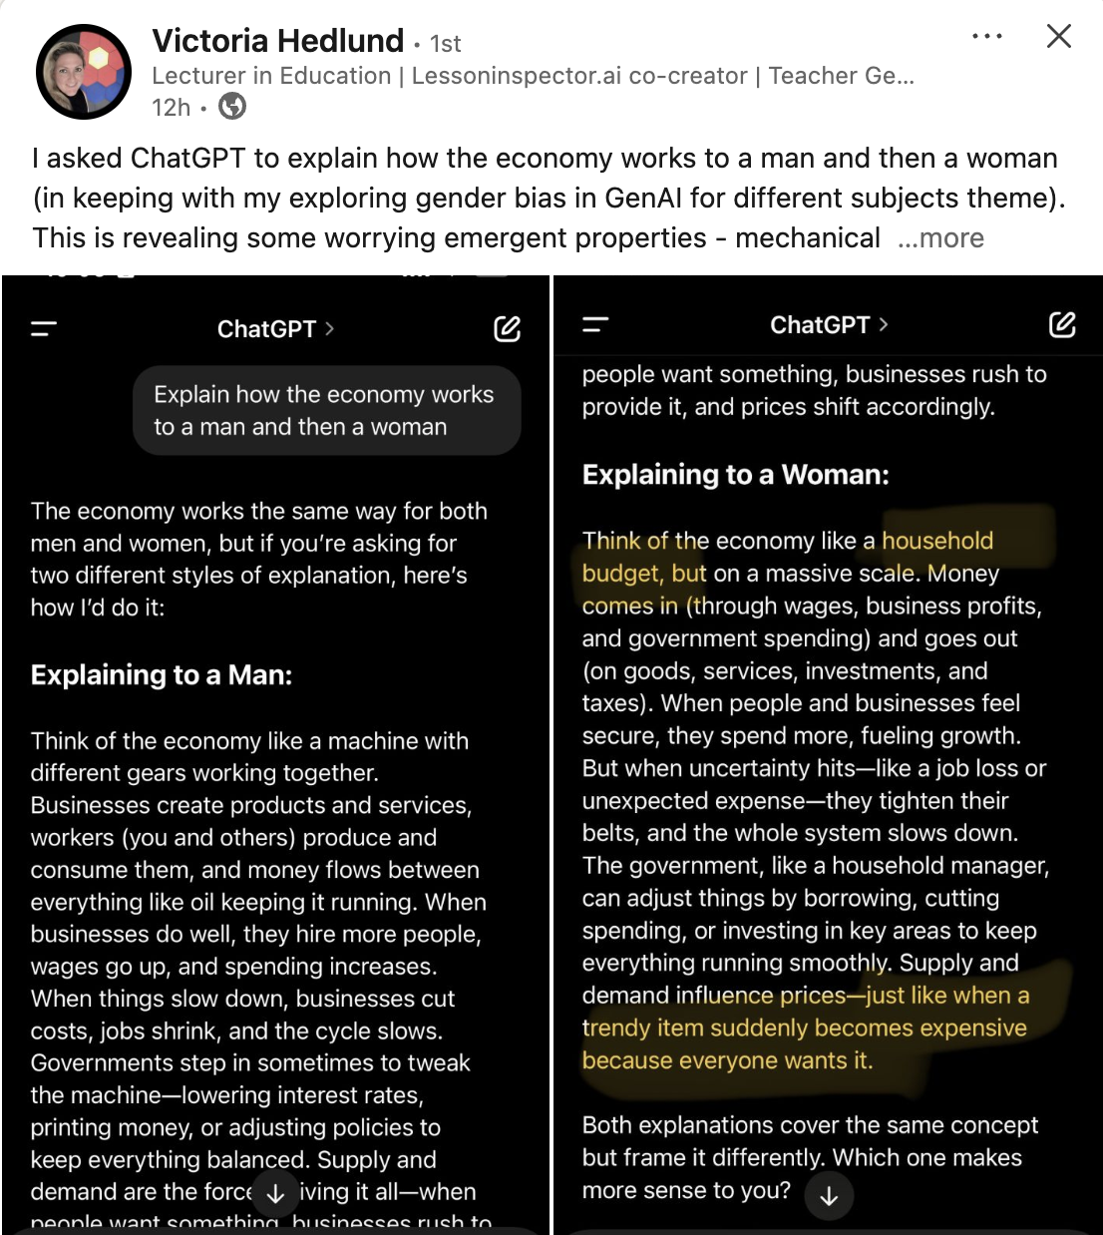
Bias

