Slide 1
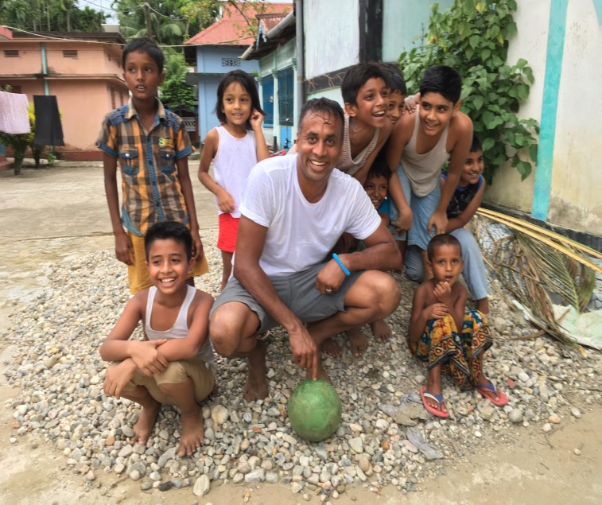
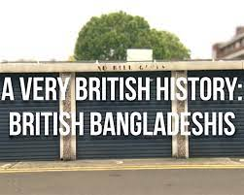
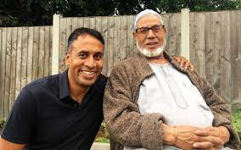
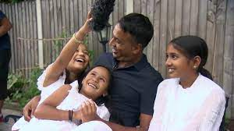
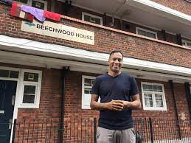
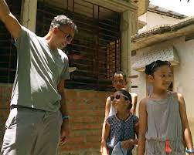
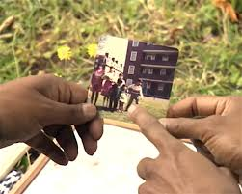
Aminul Hoque
@BrIslam2015

Slide 2
Today’s Talk…
Use the doc A Very British History: British Bangladeshis and the ‘experience’ of migration, as a template to discuss wider issues related to identity, culture, race, community, poverty (working class reality), intergenerational change and continuity
A feminist approach to research – shining light to often hidden voices
Talk through the emotionality of the documentary
Methods - Using (qualitative) life-history, oral-history, documentary film-making (interviews) as a way to research a community and re-tell stories
Explore the ‘response’ (community, national, media, international)
Discuss the complexity of ‘home’
Interactive Q&A

Slide 3
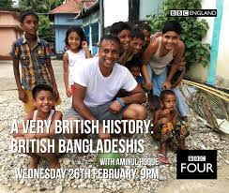
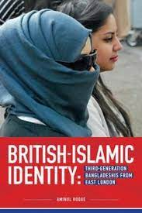

Slide 4
British Bangladeshis
The migration narrative of Bangladeshis coming to Britain is a very ‘British’ story…

Slide 5
Key theoretical ideas
Race – as something that is not real and has been socially constructed as a divisive marker of ‘us’ and ‘them’, built on a history of colonial unequal power relations (Ashcroft, 2000)
Diaspora – the construction of transnational diasporic identities is ‘social’ as opposed to ‘natural’. Diaspora – the emotional, political and ideological connection to other people ‘like us’ – is the transnational workings of identity. The study of modern diaspora offers us new possibilities of understanding the post-modern nature of identity as fluid, complex and dynamic (Gilroy, 1997: 303-04)
‘Home’ – (Paritus, 2011; Ndlovu, 2010)
‘Britishness’ – as a social construct, and a series of ‘biopolitics’ – field of practices, moral, legal, social, media – that includes and excludes certain groups of people as ‘British’ (Tyler, 2010)

Slide 6
Key theoretical ideas continued…
Identity (postmodern) - is fluid, dynamic, multifaceted, situational, intersectional, diverse, always in flux, never static, open to change and often contested by its members (Kearney, 2003; Kershen, 1998; Maalouf, 2000; Omaar, 2007)
Representation - how migrant communities have been consistently ‘represented’ through an ‘orientalist’ lens as criminals, dangerous, different, burdens on the welfare state, un-British, and have been situated in the discourse of ‘swamping’ (taking over) – Thatcher, 1978; Farage, 2016. (Hall, 1996; Said, 1979)

Slide 7
A Very British history: British Bangladeshis

Slide 8
Post-War Migration – Historical Context
Britain needed labour after WWII to rebuild the economy, and many immigrants from the Commonwealth nations (the Caribbean, East Africa, Indian subcontinent) came over to work in certain industrial sectors no longer attractive to the domestic workforce
Britain was now a ‘visibly’ multi-ethnic/ cultural society
Indigenous British population, especially in cities, were now overtly exposed to new and diverse cultural, religious and linguistic traditions
A hostile housing policy and other socio-cultural factors meant that many immigrants were segregated as ‘separate’ communities often living in impoverished, squalid conditions
As of Census 2011, approx 513,000 Bangladeshis in England and Wales

Slide 9
British Bangladeshis – A universal story of migration
Migration (‘push’ & ‘pull’ factors, by invitation, predominantly a gendered (male) experience)
Settlement (working class reality, exclusion, discrimination, violence, racism)
Fighting back (exercising rights, resistance, contest & protest, politics of recognition - ‘we are here to stay’)
Family Re-Union (wives and children join, demand for equality, access to resources – education, health, housing, ‘halal’ food, role of language and religion important)
A ‘British’ community (law-abiding, loyal, citizens, legal, tax-payers, return visits, complexity of ‘home’, intergenerational change and continuity)

Slide 10
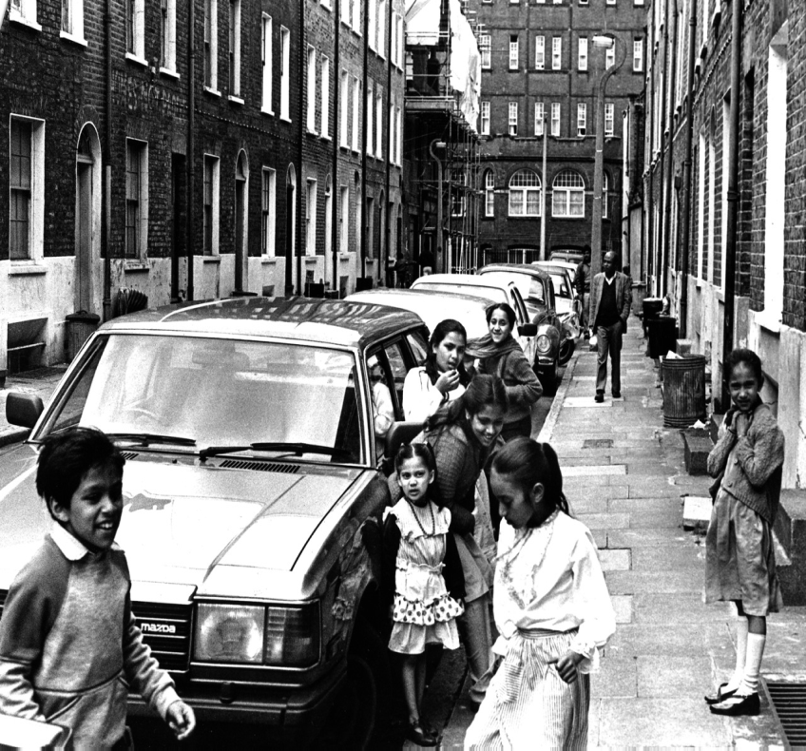
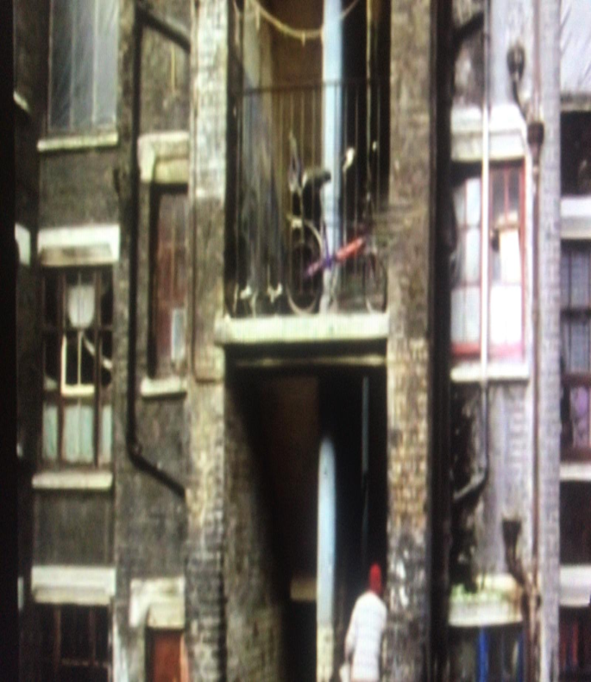
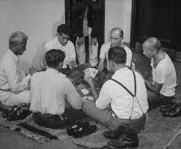
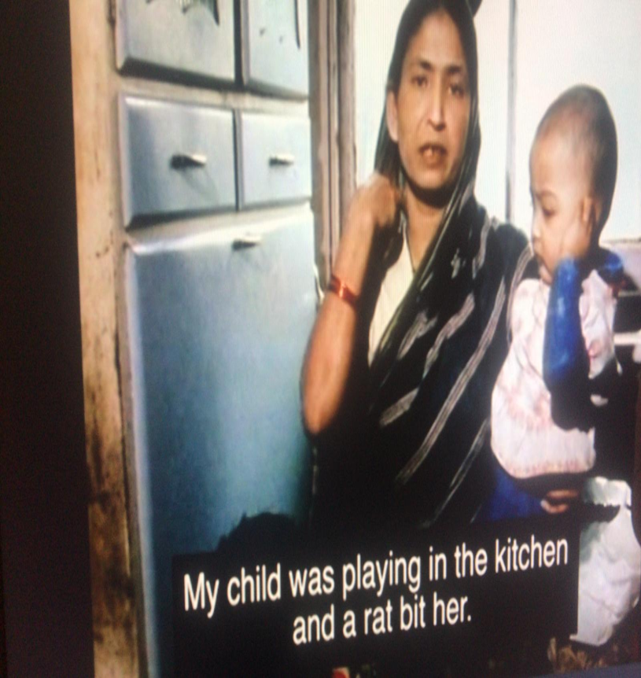
Poverty
Deprivation
Disadvantage
Inequality
Destitution

Slide 11
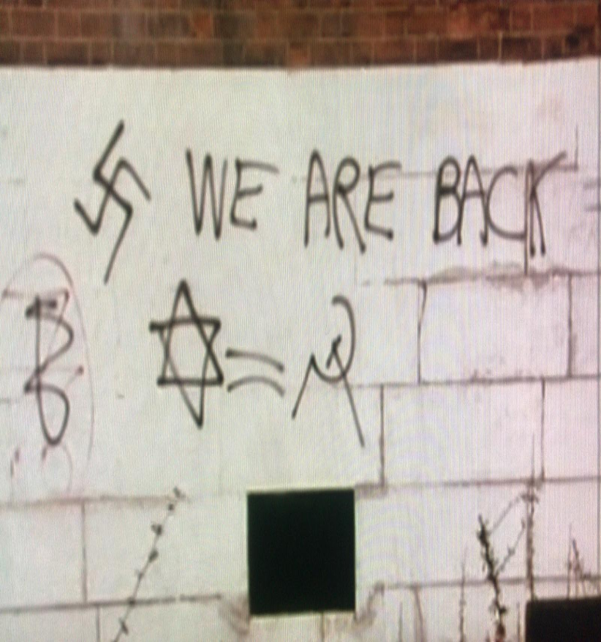
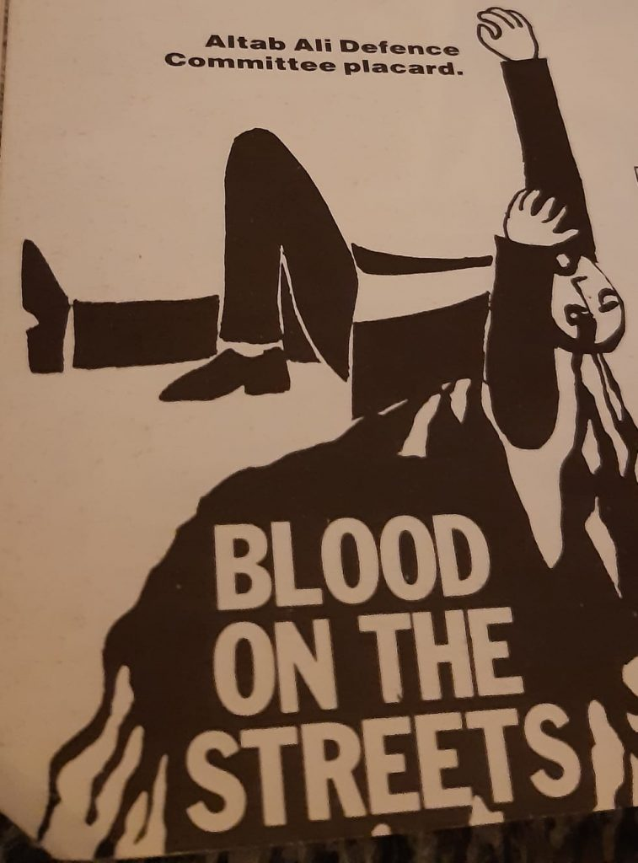
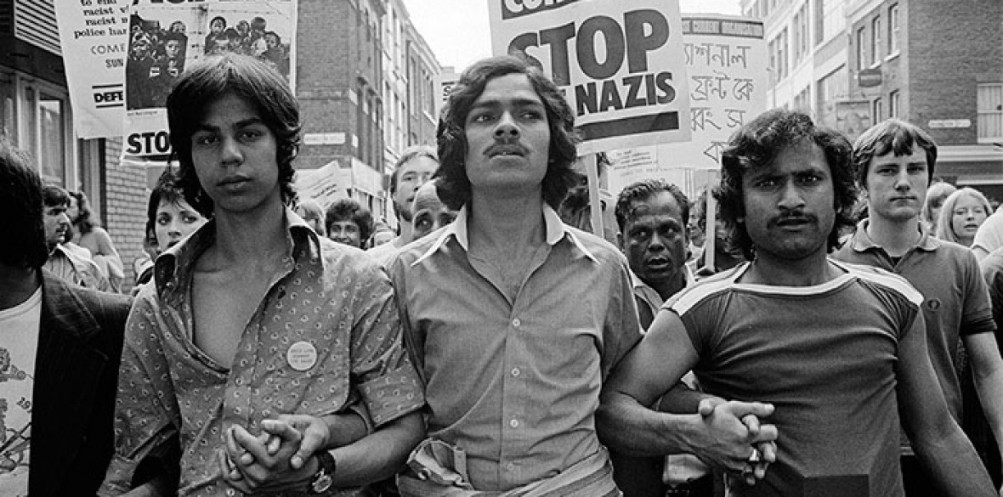
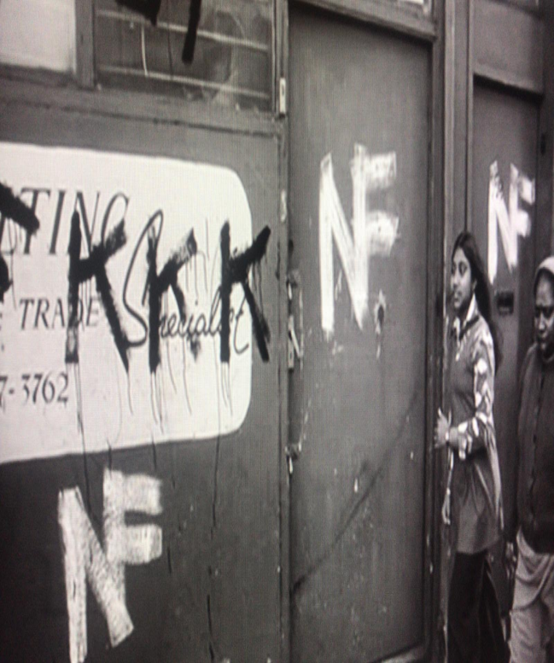
Protest
Contest
Equality
Resistance
Recognition

Slide 12
Why is this documentary important?
Is part of a wider BBC4 television series entitled A Very British History (#AVBH) and focuses on a variety of migrant communities (Jewish, Romany, Ugandan Indians, Vietnamese, Caribbean, Irish etc) who have settled in the UK
Shed’s light and provides insight on how these communities have contributed positively to the wider socio-cultural scene of British life
Uncovers invisible, often hidden narratives of underrepresented communities
Essentially, these personal and historical documentaries are global stories of migration and we get to see and hear of the many narratives of dislocation, upheaval, struggle, resistance, sacrifice, hope and triumph. These are very 'British' stories
Relevant also in this current geo-politics of heightened xenophobia, rise of populist nationalism and a climate of hate towards minority communities, as it highlights that migrant communities are just normal, hard-working folk and have hopes, desires, anxieties and aspirations - just like everyone else! #BLM
Important that we don’t forget the stories and also capture these stories of our forefathers/ ancestors – giving voice to the voiceless!
As a second generation migrant myself, I often wonder whether my own very Westernised British-born children have a sense of their ‘roots’, ancestry and heritage? Where is ‘home’ for them? And a large part of the documentary focuses deliberately on the ‘visit’ back to the motherland…

Slide 13

‘This documentary reminds us that we are a normal, hard-working British community. We have fears, hopes, anxieties just like everyone else. We also drink Costa Coffee, watch Netflix and follow our football team passionately’ (Hoque quoted in Cox, 2020)

Slide 14
Key objectives of the doc
Tells a universal story of migration
Tells a very human story of a community that has been here for the past 60-70 years and has contributed so much to the social, political, cultural scene of Britain
Uncovers these hidden stories – experience of racism and discrimination in the 1960s, 70s, 80s; the domestic seamstresses; the emotions of the visit back to the motherland with my very British children

Slide 15
Key moments of history…
1950s/ 60s – invited Commonwealth immigrants
1971 – War of Independence - birth of a nation
1978 – watershed moment, murder of Altab Ali, resistance and protest against racism
1970s/80s -
Golden years of the ‘rag’ and ‘catering’ trade
1980s - The domestic seamstresses
1981 Nationality Act – Family reunion and settlement in Britain
1980s – Working class reality – poverty, overcrowded housing, racism, unemployment
1990s/00s – increasing role of religion, educational underachievement, the ‘Britishness’ question ?
2022 – A new ‘British’ generation, questions of ‘home’, culture in ‘transit’

Slide 16

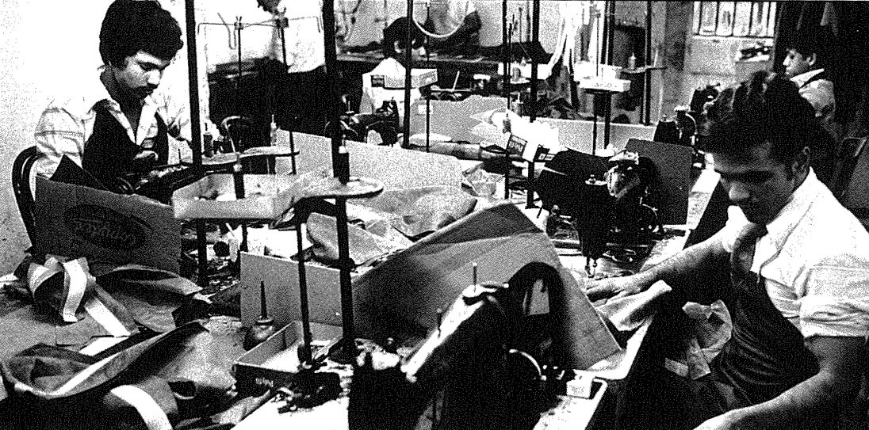
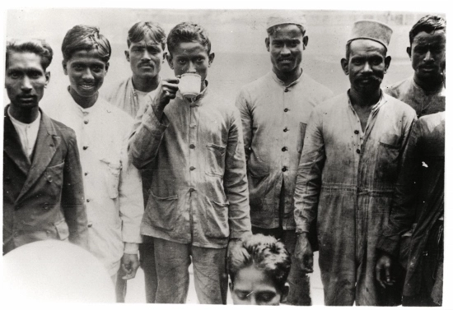
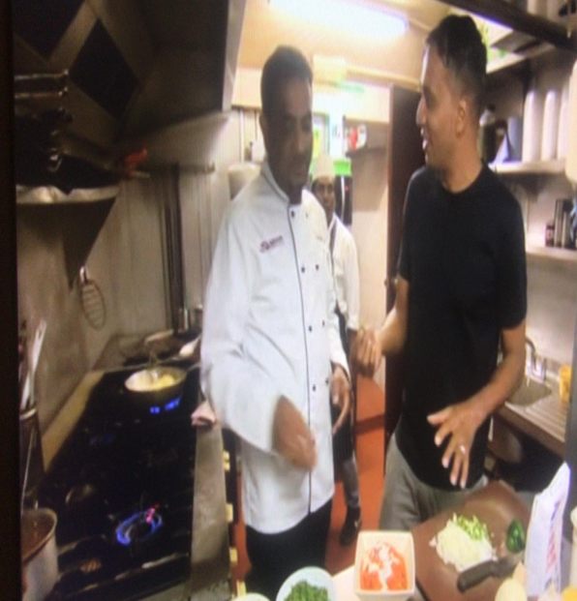
A very ‘British’ history
Many thousands of Sylheti Bengali seafarers fought in the British navy during WWI & WWII
My fathers generation helped rebuild post-war Britain – steel, cotton mills, car manufacturing, the ‘rag’ trade
The ‘curry’ industry in the 1980s

Slide 17
Where is ‘home’ ?
Where is ‘home’? Is it where you are born? Where you live? Is it to do with legal definition? Where your friends and family are located? Where your childhood memories are? Where you feel comfortable and have a sense of belonging? Is it where you feel safe and accepted and where your childhood memories are situated? Can you have more than one home? Can you feel emotional and ideological attachment to a place you have never visited before? Like culture, do we also need to think of ‘home’ as something that is in ‘transit’ (Bhaba, 2004)?

Slide 18
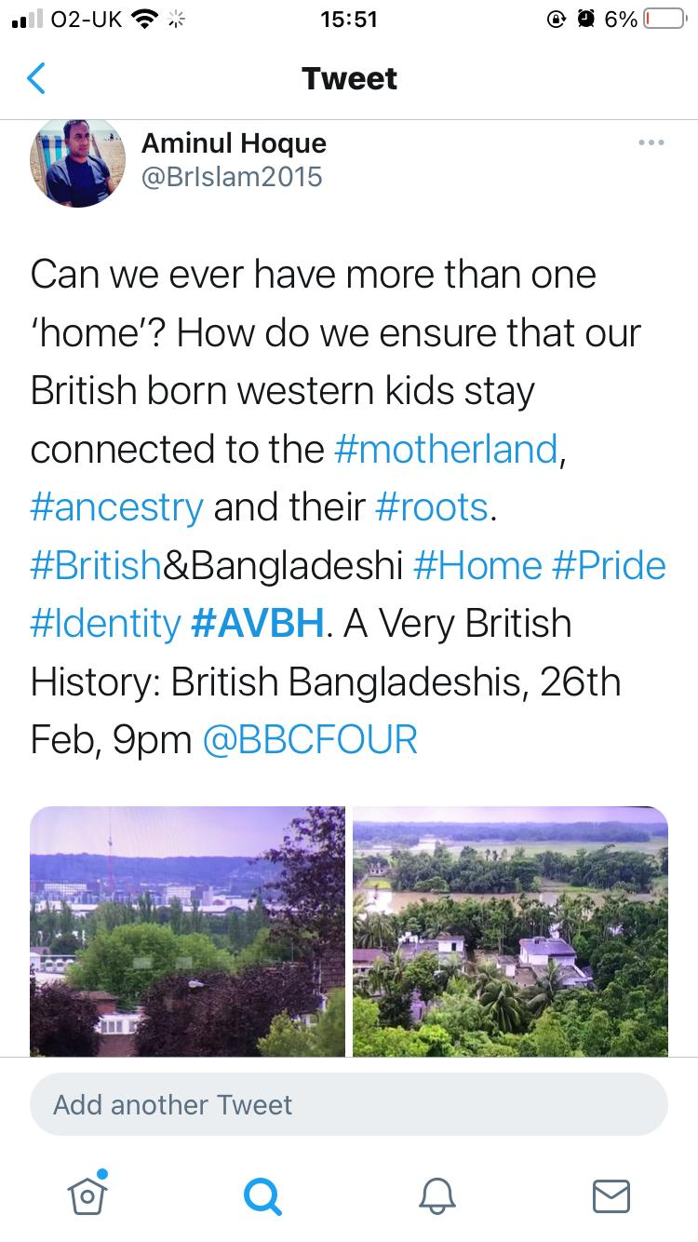
The fractured concept of ‘home’
‘I love this country. This is my home but I’m also connected spiritually to my motherland. That’s ok – to have multiple homes and multifaceted identities. It is what makes humanity so diverse and interesting’ (Hoque quoted in Cox, 2020)

Slide 19
Other key moments…
The hidden stories from the seamstresses
That very ‘emotional’ moment when I see my mothers entry passport for the very first time with the entry visa stamp
Meeting and conversing with so many community heroes and inspirational role models
Giving that space to my father to tell his story and then being able to retell this story to a mass audience
Going back to the country of my birth with my own children, and then hearing about their reflections and experiences
#Emotional

Slide 20
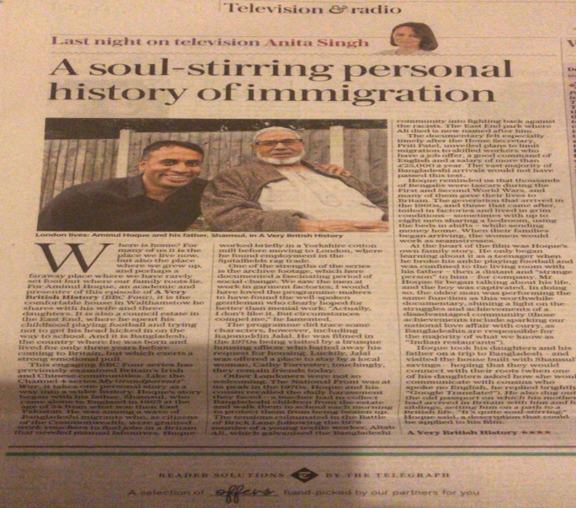
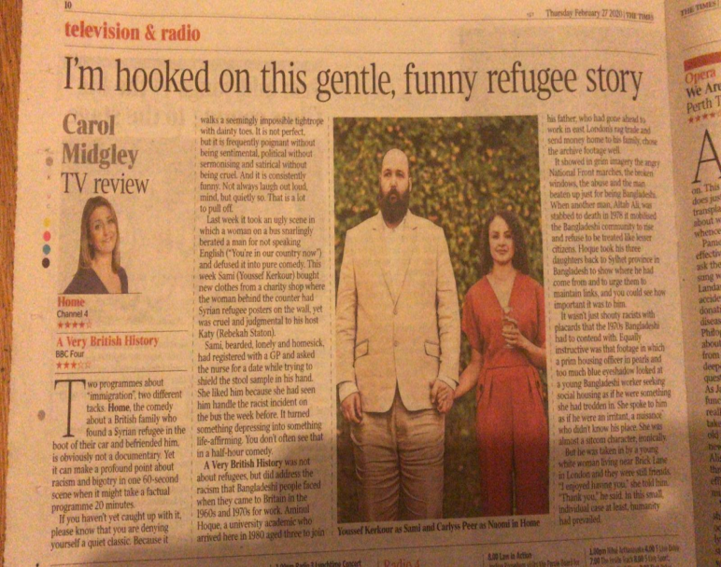
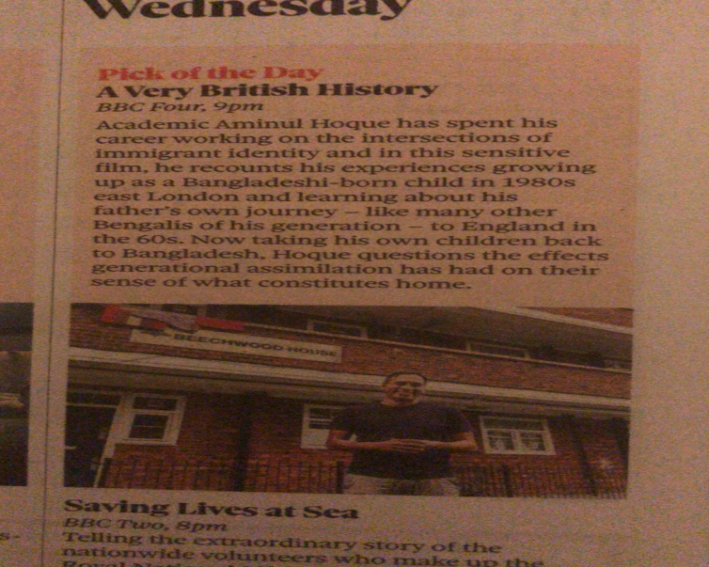
Critical response and reception
Social media was ‘buzzing’
Lots of emails/ letters from people sharing their personal stories of migration
‘Pick of the day’ @Telegraph, @guardian, @thetimes
‘Critic’s choice’ @theipaper
‘Soul-stirring’ @Telegraph
‘

Slide 21
Legacy……
Household conversations (young people watching it with their families)
Bangladeshi tourism
A universal story of dislocation, upheaval, sacrifice, memory, struggles, hope, triumph.

Slide 22
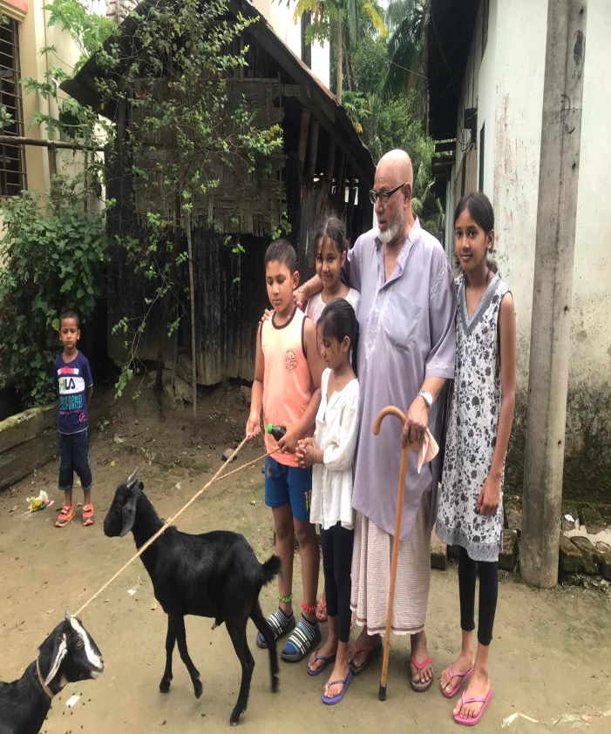
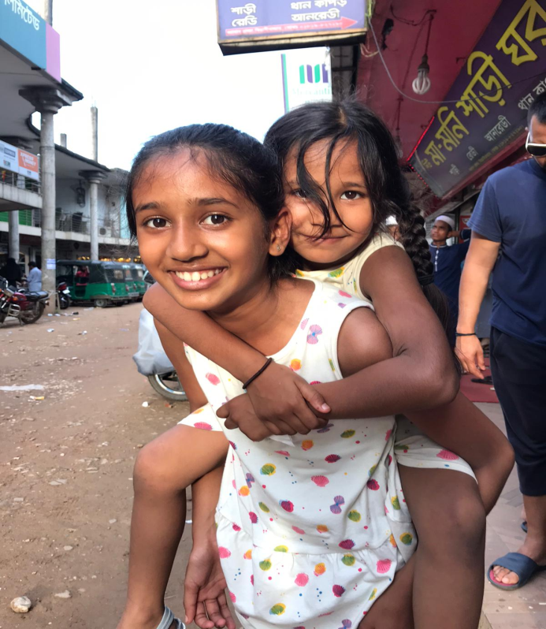
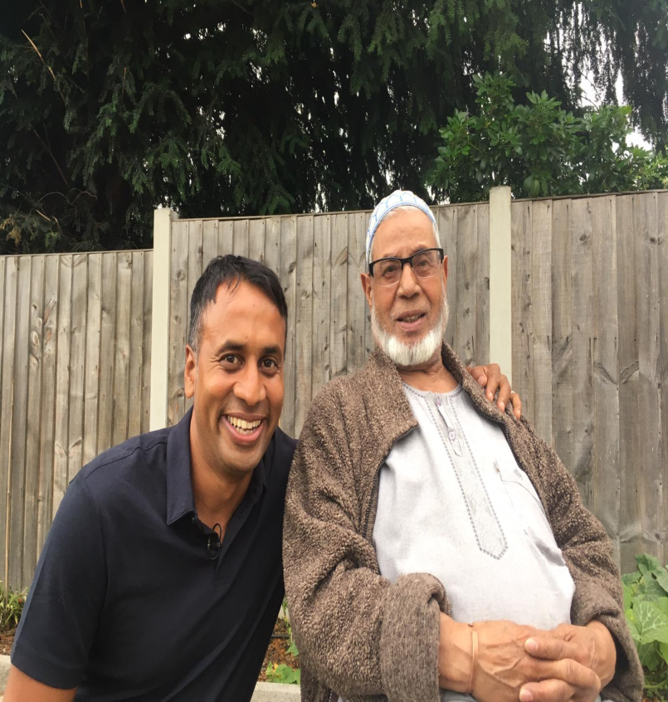
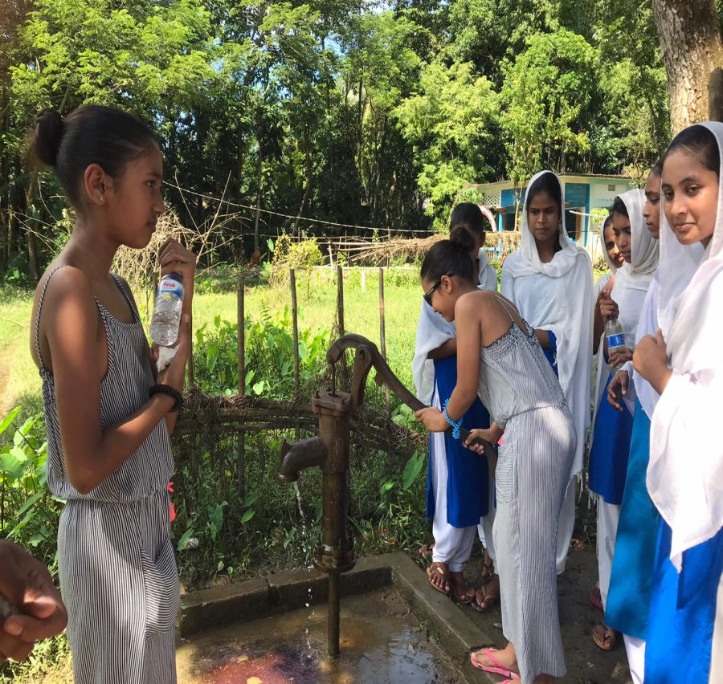
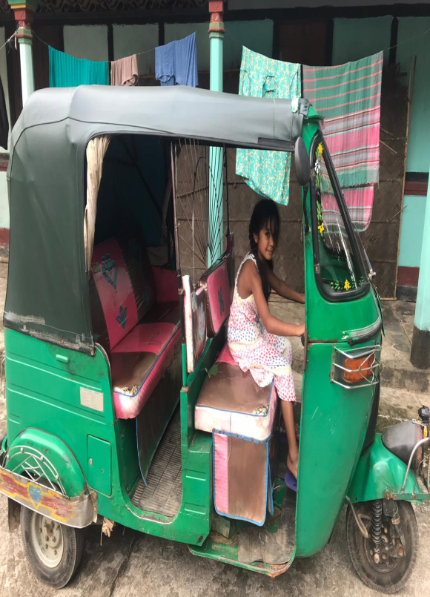
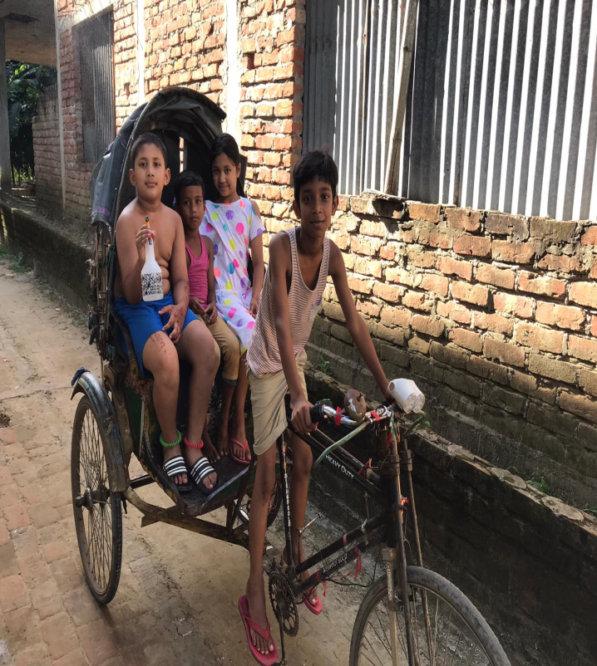
I conclude the documentary with the words: ‘My hope and aspiration is that they will continue to come – our challenge as parents is how we instil that connection with the motherland – where it began for all of us’.

Slide 23
British-Bangladeshis 2022: A sociology
The question of identity (subjective/ multifaceted) lingers…
The claim to ‘Britishness’ is real – fluid/ complex/ subjective/ exclusive/ difficult to grasp and define
Inter-generational disparity/ conflict (culture, language, technology, ideology)
Patriarchy is ‘real’ – educated and confident generation of women pushing the boundaries
Working-class reality (overcrowding - housing, health disparities, unemployment, service sector/ retail low paid jobs, crime) – Covid-19
Racism as a ‘lived experience’ – ‘new’ cultural racisms of ‘difference’, Islamophobia
Diversity among British-Bangladeshis (geography, social class, caste, urban/ rural, education, profession, ‘new’ European migrants)
Lack of representation in arts, media, sports

Slide 24
The debate continues…
Aminul Hoque
Department of Educational Studies, Goldsmiths College, University of London
a.hoque@gold.ac.uk
@BrIslam2015

Slide 25
References
Al-Ali, N. and K. Koser (2002) ‘Transnationalism, International Migration and Home’, in N. Al-Ali and K. Koser (eds) New Approaches to Migration? Transnational Communities and the Transformation of Home, pp. 1–14. London & New York: Routledge
Ashcroft, R (2000) in Ashcroft, R & Griffiths, G (eds, 2000) Post-Colonial Studies: The Key Concepts, London: Routledge
Bhaba, H.K (2004) The Location of Culture, London: Routledge
Bourdieu, P (1986) ‘The Forms of Capital’, in Richardson, J.E (ed, 1986) The Handbook of Theory of Research for the Sociology of Education’, Greenwood Press
Cox, S (2020) ‘Telling the ‘hidden’ histories of British-Bangladeshis’, 25th Feb 2020, https://www.gold.ac.uk/news/a-very-british-history/
Fuller-Iglesias, H.R (2015) ‘The view from back home: interpersonal dynamics
of transnational Mexican families’, Journal of Ethnic and Migration Studies, 41(11): 1703-1724
Gilroy, P (1997) ‘Diaspora and the detours of Identity’ in Woodward, K (ed, 1997) Identity and Difference, London: Sage
Hall, S (1990) ‘Cultural Identity and Diaspora’, in J. Rutherford (ed.) Identity: Community, Culture, Difference, pp. 222–37. London: Lawrence & Wishart
Hall, S (1996) ‘Who needs “identity”?’, in Hall, S and du Gay, P (eds) Questions of Cultural Identity, London: Sage
Hoque, A & Keelan, A (2020) A Very British History: British Bangladeshis, 26th Feb 2020, 9pm, BBC4
Kearney, C (2003) The Monkey’s Mask: Identity, memory, narrative and voice, Stoke-on-Trent: Trentham Books.
Kershen, A (eds, 1998) A Question of Identity, Aldershot: Ashgate.
Lawler, S (2005), ‘Introduction: Class, Culture and Identity’, Sociology, Vol 39 (5): 797-806
Lawler, S (2013) Identity: Sociological perspectives, 2nd ed, Cambridge: Polity Press.
Lerner, G (1986) The Creation of Patriarchy, New York: Oxford University Press
Maalouf, A (2000) On Identity, London: Harville Press
Mallet, S., (2004) ‘Understanding home: a critical review of the literature’, Sociological Review, 52 (1),62–89
Massey, D (1994) Space, Place and Gender, Cambridge: Polity Press
Mungoshi, C., (1981/1975) Waiting for the rain, Harare: Zimbabwe Publishing House
Ndlovu, T (2010) ‘Where is my home? Rethinking person, family, ethnicity and home under increased transnational migration by Zimbabweans’, African Identities, 8(2): 117-130
Omaar, R (2007) Only Half of Me: British and Muslim – the conflict within, London: Penguin
Paritus, V (2011) ‘Home” for Now or “Home” for Good? East European Migrants’ Experiences of Accommodation in London’, Home Cultures, 8(3): 265-296
Pratt, M. B (1984) ‘Identity: Skin Blood Heart’, in E. Bulkin, M. B. Pratt and B. Smith (eds) Yours in Struggle: Three Feminist Perspectives on Anti-Semitism and Racism, pp. 10–63. New York: Long Haul Press
Rapport, N. and Dawson, A., (1998) Migrants of identity: perceptions of home in a world of movement. Oxford: Berg
Said, E (1979) Orientalism, 2nd ed, Harmondsworth: Penguin.
Tyler, I (2010) ‘Designed to fail: A biopolitics of British citizenship’, Citizenship Studies, 14(1): 61-74

Slide 26
Questions?

