Slide 1
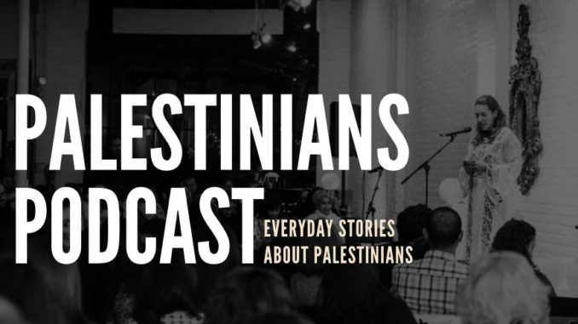
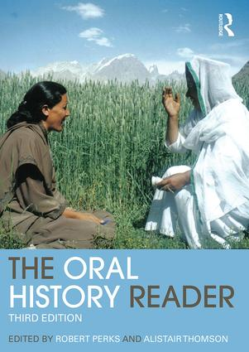

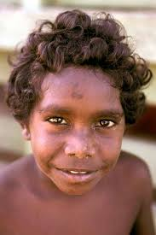
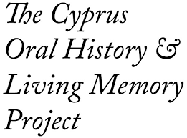
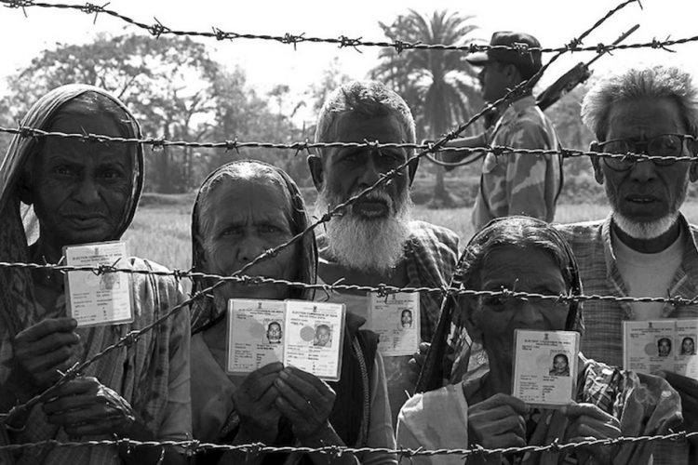
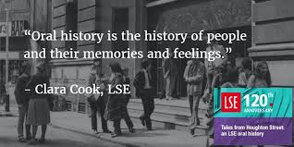

Slide 2
Oral history – a ‘starting’ definition
Oral history refers both to a method of recording and preserving oral testimony and to the product of that process. ... A verbal document, the oral history, results from this process and is preserved and made available in different forms to other users, researchers, and the public.
(Oral History Association, 2009)
Because it is a primary source, an oral history is not intended to present a final, verified, or "objective" narrative of events, or a comprehensive history of a place... It is a spoken account, reflects personal opinion offered by the narrator, and as such it is subjective. Oral histories may be used together with other primary sources as well as secondary sources to gain understanding and insight into history.
(University of California, Santa Cruz)

Slide 3
The importance of ‘oral’ history
Oral history is both an approach and a method
The participant(s) is asked to reflect (in-depth) upon specific events or periods in the past. Oral history, with its combination of methods drawn from history and sociology, places emphasis on the significance of temporal context and memory by interviewing people about their past experience.
Emphasis is less upon the individual and more around the event (different to the life history approach).
The oral history interview is a dialogue, a social relationship between two, or more people.
Can be combined with other sources such as documents, photos (visual methods).
Largely unstructured and highly reflexive

Slide 4
Limitations
Small sample – can we generalise? Should that be the objective?
Bias/ selective memory
The problem with memory, lapses, editing, distortion (Grele, 1998)
Will the participants be telling us what they want to tell us OR what we want to hear?
Narratives and stories can be fictional, exaggerated, dramatic, edited and confessional

Slide 5
Advantages
Insightful
Offers ‘understanding’ of an event/ incident
Rich in detail
Participants re-tell stories and take you on a journey
‘Thick description’ (Geertz, 1973)
Genuine, authentic accounts of events
An ‘attempt’ to see the world from ‘their’ perspective
Oral testimonies have allowed the voices and experiences to come through of groups that are typically marginalised in research – a social justice agenda

Slide 6
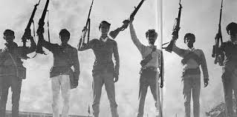
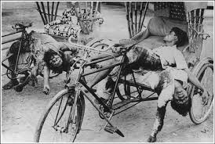
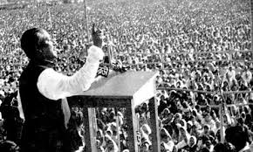
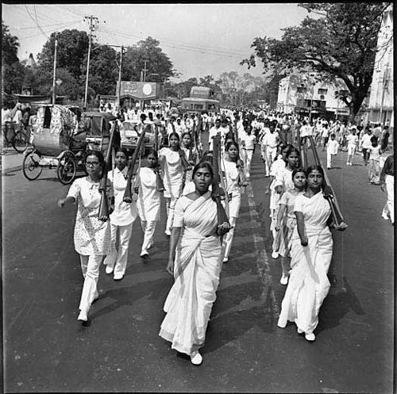
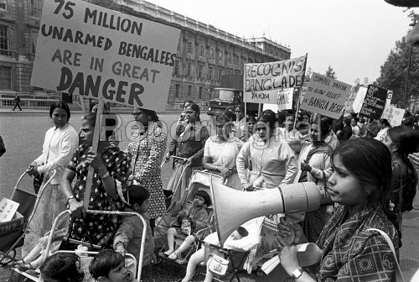
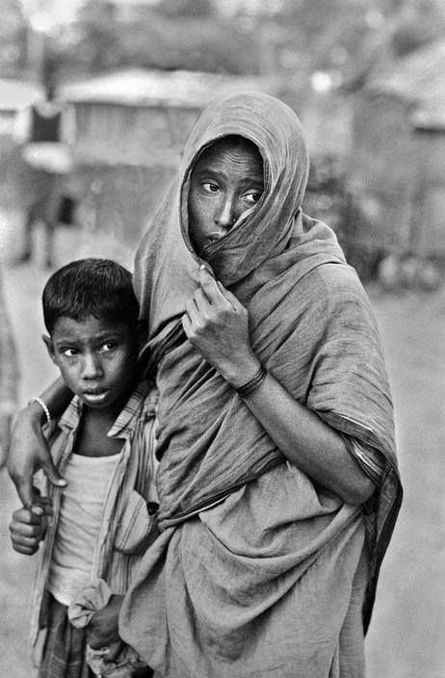
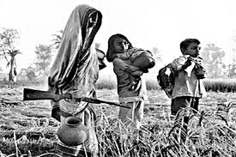
The Bangladesh Liberation War, 1971

Slide 7
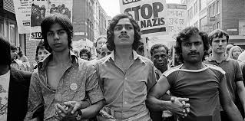
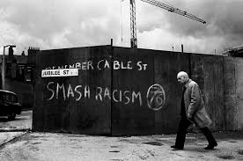
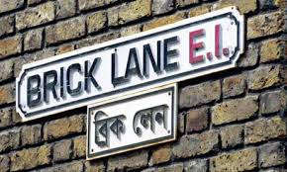
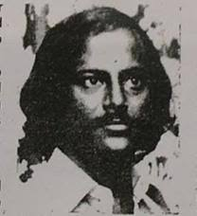
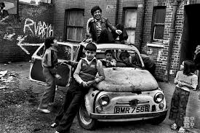
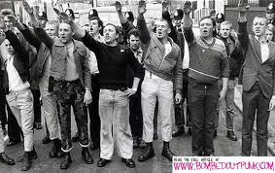
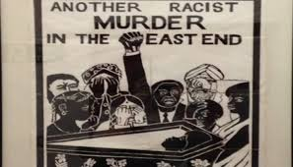
The racist murder of Altab Ali, 1978

Slide 8
‘…There were raids by the skin head and the National Front smashing windows and shop fronts in Brick Lane. ‘Paki-Bashing’ was a daily occurrence in schools, parks and streets. As a child, my parents did not take me to the park in fear of racist attacks. In 1974 a few of us formed a football team. Caroline Adams was a youth worker who took us to play with a white team at Victoria Park. We won the game. They could not accept defeat from a dark coloured team. After the game for no apparent reason they began ‘paki-bashing’, chasing us around the park kicking, punching and calling us nasty names. I remember Caroline Adams trying her best to stop crying and fearing for the worst.
When Altab Ali was murdered in May 1978, fear spread within the community. People were afraid of going to work, sending their kids to school, travelling on public transport…

Slide 9
… Altab Ali was a kind polite person. I remember he used to offer me chewing gum whenever I met him at my uncles factory where he used to work as a leather machinist… I was 15 at the time. I saw him at the factory two days before he was murdered. He was attacked in the evening on his way home from work. I remember the following day I went into the factory in the basement after school. Everyone who worked at the factory was there but none was working. All were in a state of shock… I heard that Altab Ali’s mother cried for months for her only son’

Slide 10
Insider/ Outsider conundrums
Insider
Am Bangladeshi
East End boy
A fellow footballer
Cultural/ religious/ linguistic similarities
Experienced racism
Have family members who were around during 1971 and 1978
Gender similarities to male participants
Outsider
Did not witness first-hand any of the events (1971 and 1978)
University-based academic researcher (power dynamics)
Now live in suburban north-east London (geographical and social class differences)
Expected to fill in gaps… ‘you know how it is…’
Age difference to participants
Gender difference to female participants

Slide 11
The ethnographic tension
(Martin Hammersley)
As researchers, do we merely re-tell the oral histories of the narrators and let the audience make sense of what they read and hear?
OR
Do we interpret, use our ethnographic and sociological imagination, and analyse what we see, hear and read, before presenting it to the reader?

Slide 12
References
Geertz, C (1973) The Interpretation of Cultures, New York: Basic Books Inc
Grele, R.J (1998) ‘Movement without aim: Methodological and Theoretical problems in oral history’ in R. Perks and A.Thomson (eds) The History Reader, London: Routledge
St Hilda’s East Community Centre (1999) ‘The way we worked: An oral history by members of St Hilda’s East Community Centre and Stepney Jewish Community Centre’, September 1999

