Slide 1
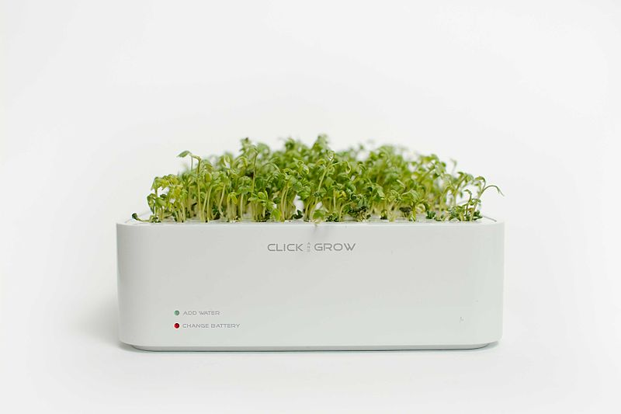
GROwing Open Access
OPEN ACCESS PUBLICATION FOR PHD STUDENTS AND EARLY CAREER RESEARCHERS

Slide 2
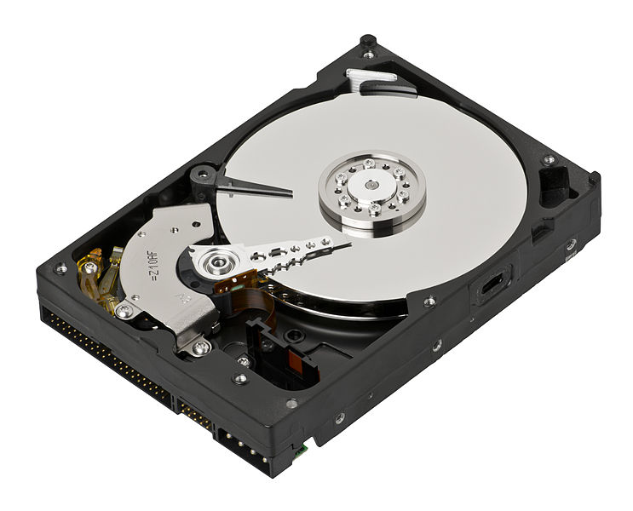
What is a Repository?
A burial vault or tomb
A place or container in which things can be stored for safety
A digital repository is a mechanism
for managing and storing digital
content
Notes:
Dictionary definitions
Not somewhere to put things to sleep/bed/death – it’s a beginning
An online facility/service to store outputs in different formats
Advantages in preservation, sharing ability, permanence

Slide 3

What is Open Access
Free and unrestricted access to research outputs
Wider sharing of research
Copyright remains
Originally just research articles
Any type of output
Notes:
Integral part of research is dissemination

Slide 4
Why Open Access?
University/
Taxpayer funds research
Researcher produces ‘paper’
Paper handed to publisher at no cost
Publisher sells to University paid by Taxpayer/
Student
Notes:
profit margins in the range 32–42%

Slide 5
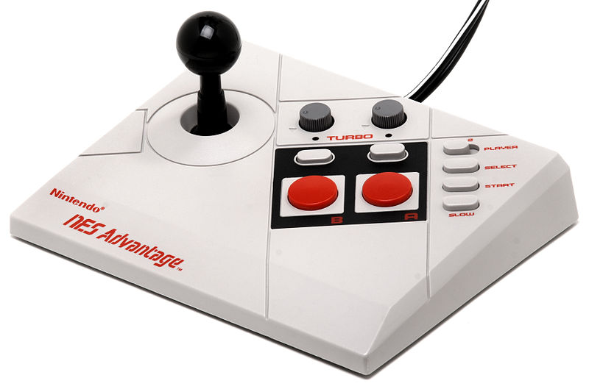
Advantages
Visibility
Organisational Tool
Authoritative record
Persistent urls
Storage
Sharing, increasing access and opportunities
Preservation
REFable
Export to other systems
Use for CV
Notes:
Visibility – creating an academic profile now, one of the tools you now need alongside academia.edu, linked-in, orcid
Part of online network, link to/share your research online – increases opportunities for academic collaboration , identifying shared expertise– conference invites
Provides an authoritative record, established at an academic insitution, more recognized
Organizational tool
Publication lists, cvs, applying for funding, research posts, conferences
Sharing beyond paywall, geographic location no barrier, international/global reach
Persistent urls
Exposes the item records to Google Scholar etc, the more metadata the better
Not just article/printed word research, provide equal platform for practice based research
Future REF

Slide 6
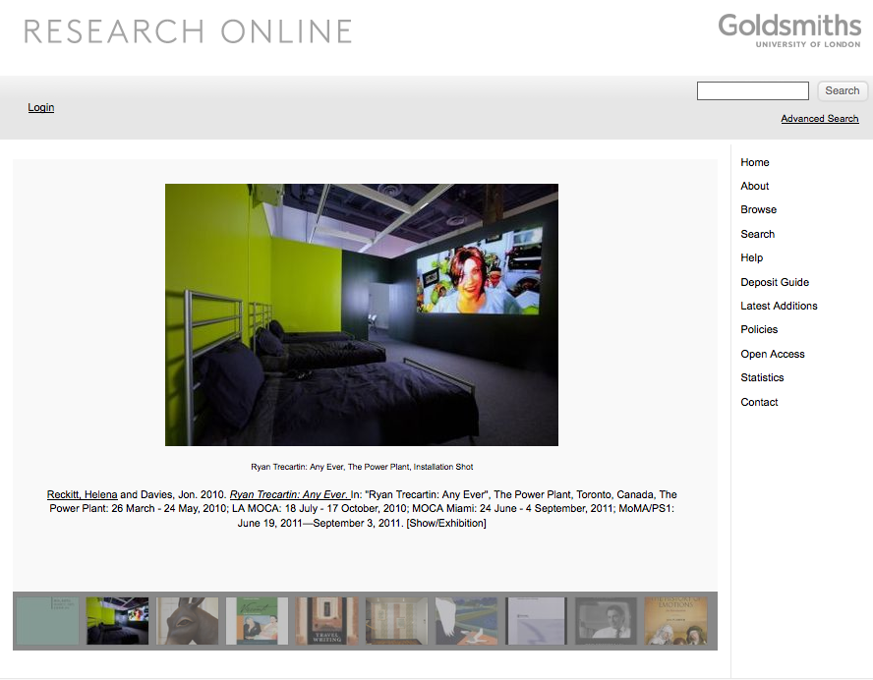
Goldsmiths Research Online – GRO http://research.gold.ac.uk/
Notes:
All academic and PhD students automatically can login and add items
Reviewed and edited, metadata added by gro team
Add a minimum – name title, what it is, where its from – we will add in the extra metadata to make it more useful, encourage you to add more
We will provide one to one training and advice and support
Stats: 875,553 total downloads
Most downloaded – article11,684- thesis, book 6068

Slide 7
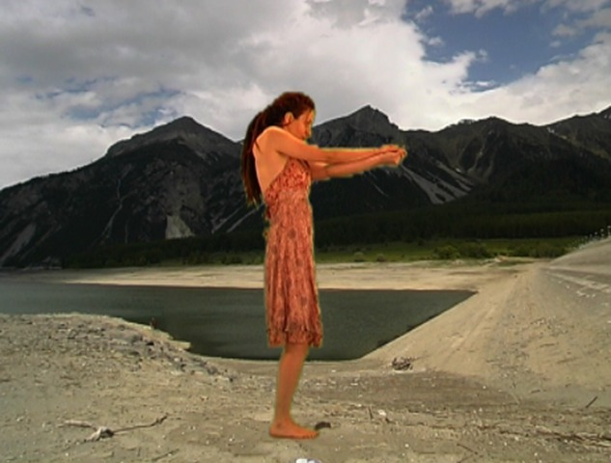
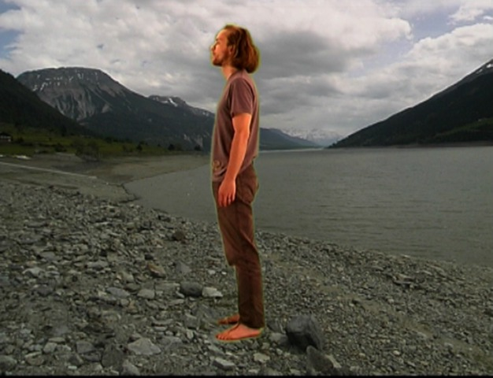
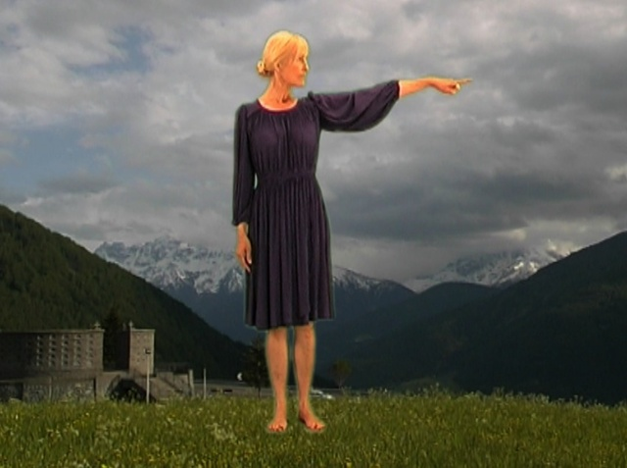
Practice Based Research
Add, contribute
Form of self archiving
Gallery websites disappear…
No current funder requirements
Audio, video, images, documentation, installation shots

Slide 8
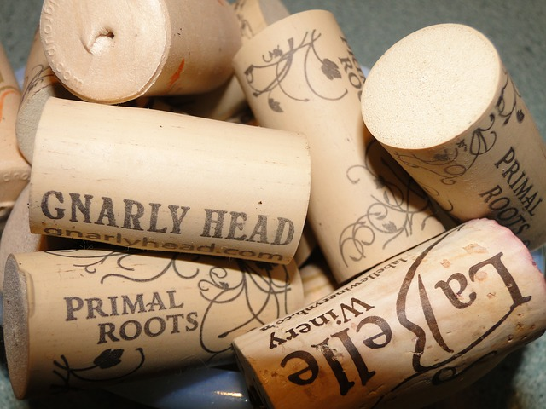
What can I add?
Articles, Conference papers/proceedings, Posters, Slides, Videos, Blogs, Professional Activities, Reports, Books, Book Reviews, Audio, Infographics, Tweets, Datasets, Patents, Compositions, Broadcasts, Images, Software, Design, Other

Slide 9
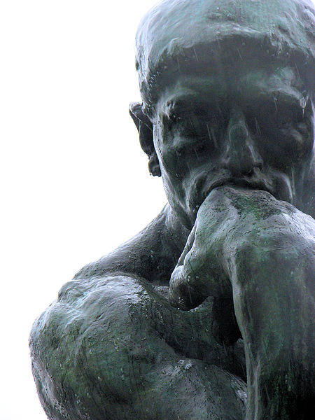
Points to Consider
Future publication affected?
Check with publisher/supervisor
Just create a bibliographic record
Upload low-res images/video
Theses – request an embargo
Funded? OA requirement
Notes:
Making research open affecting future publication possibilities – need to be considered, varies from discipline to discipline, speak with your own supervisors, colleagues
Just create an item record if in doubt, evidence that you were at a conference, presented a paper (be aware that for next REF that if your conference paper is published in a proceedings issue ISSN then it must be deposited/made open)
You can restrict the items, so no one has access
Visual material – probably don’t want to upload a high res version of the images/videos but you can store those versions in there – useful in organizing
Theses – Goldsmiths requires a digital copy to be submitted so that we can store but does not require that you make it OA – if in doubt tick/request an embargo – at later date you may want to make open – stats about theses – 11,684- thesis
Looking at alternative metric counters, so not just downloads – will help in other disciplines

Slide 10

Copyright
The right to decide how your work is used
You own the copyright until you give it away
Copyright Transfer Agreement
License to publish
Addendum
Notes:
Important – as the creator of a work you own the copyright, you decide how it can be used within the law and exceptions – your work the result of your experience, effort, networks
Journals – publishers always ask for transfer of copyright – you no longer can decide how it is used, publishers do not need this to publish your work, license to publish – addenda
Research publicly/institutionally funded, given to publisher for free, peer reviewed for free by academics – sold back to universities in subscriptions – enormous profits – serials crisis

Slide 11
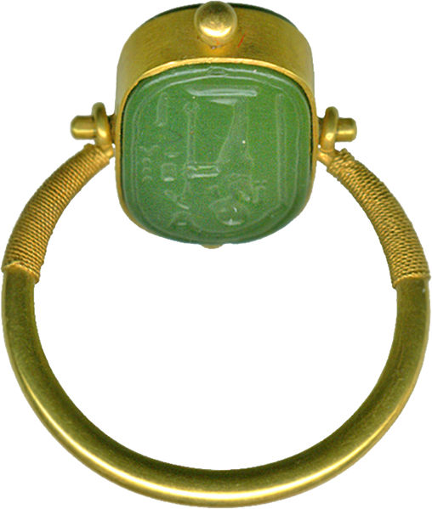
Green and Gold
Different types of Open Access
Green – Self Archiving, earlier version, no fee, maybe an embargo
Gold – Publisher makes available publisher pdf, can be a fee, no embargo

Slide 12

Creative Commons
Copyright still exists - you decide how you want others to use your material
CC-BY-NC-ND – most restrictive, no adaptation, non commercial
CC-BY – one of most liberal, any reuse as long as you are credited, allows translations, blog use
CC-BY-SA – allows adaptation, commercial use but cannot sell
Notes:
You still have copyright, does not remove copyright, just states clearly what you allow others to do
CC-BY-NC-ND – most restrictive, non commercial, does not allow parts of your work to be taken and combined with others or adapted e.g. teaching
CC-BY – opposite end, adapation, reuse even for commercial purposes – mostly used in STEM, allows translations, to be put on blogs, companies to use them (small as well as large) must always be credited – commercial – pubishers already do this, they don’t have to ask you to adapt, resell elsewhere
NC most important for creative/visual work

Slide 13
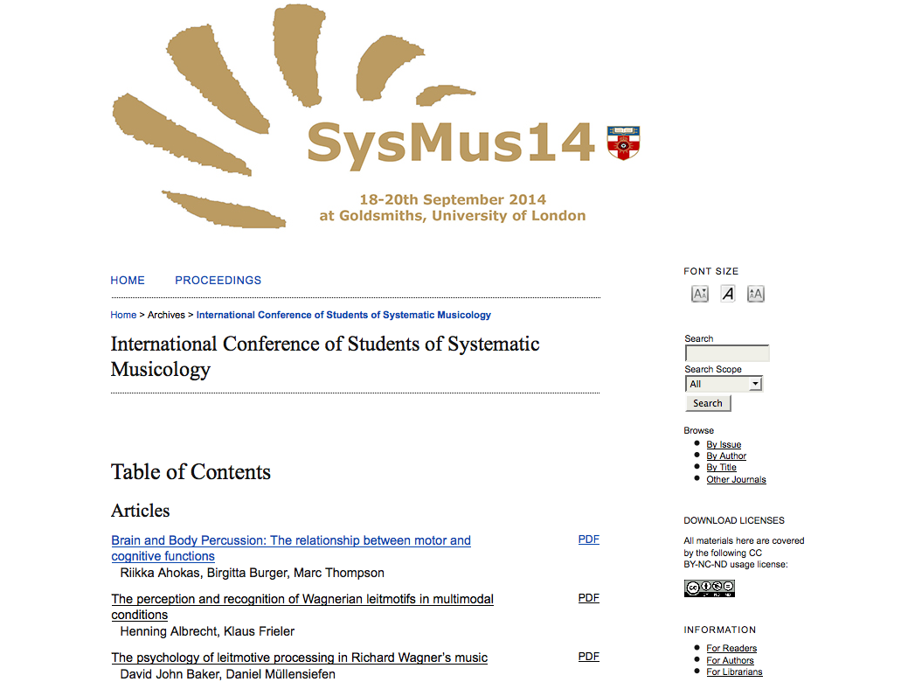
Open Journals System http://ojs.gold.ac.uk/
Notes:
2 journals, 1 conf proceeding, new journal later this year

Slide 14
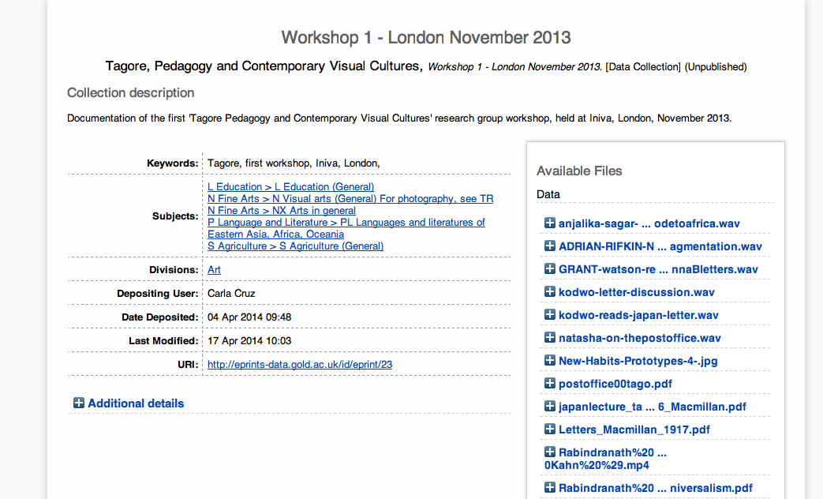
Data Repository http://data.gold.ac.uk/
Notes:
Growing area, big data, technology allowing us to read, sift through vast amounts of information to look for new solutions, new idea, new research – funder requirements – publishers very interested in data, will become extremely important in the near future
Arts – what is research data here? Ongoing question/debate. The supporting material – in practice the event point – an exhibition/performance – the research output, the material leading up to this is the data, multiple files/images/sketches/interviews/audio

Slide 15
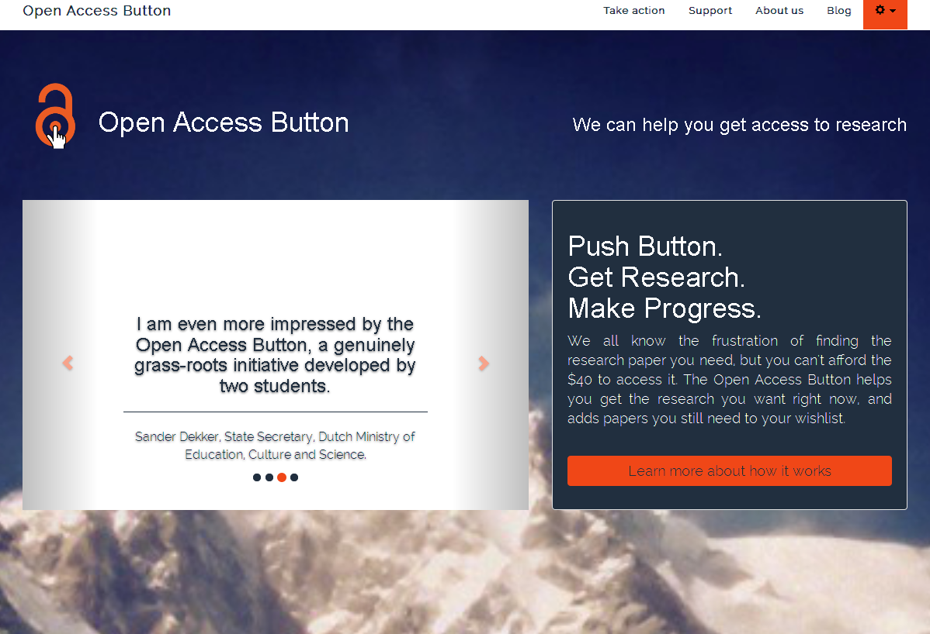
Open Access Button https://www.openaccessbutton.org/
Notes:
Started by Phd Students
To log hitting paywalls, using social media highlight the issue and allowing you to try and find an open version or to email the author
The technology to achieve open access is here, the tools are improving all the time, new possibilities, the biggest hurdle has been cultural, academics not sharing/depositing

Slide 16
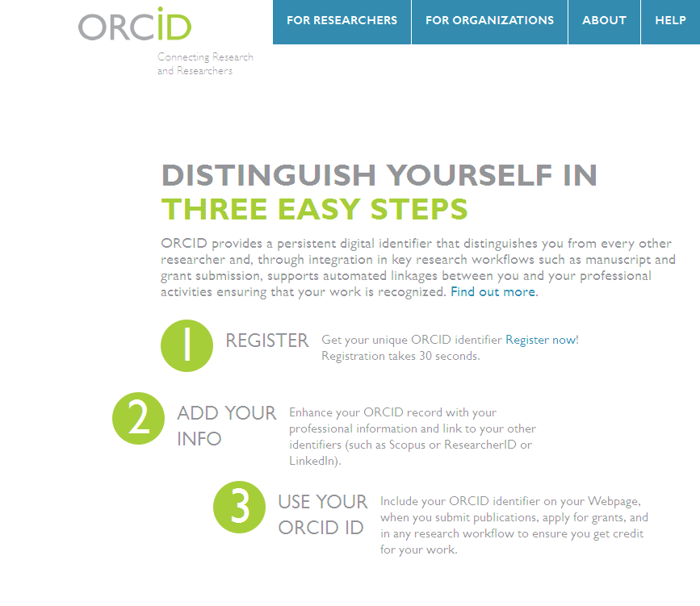
ORCID http://orcid.org/
Notes:
Unique identifier – follows your from institution
Free
Distinguishes your from others, clearly links up your work/practice

Slide 17
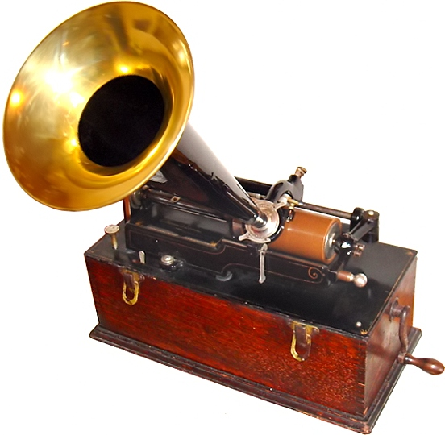
Contact
GRO Team
gro@gold.ac.uk
Andrew Gray
a.gray@gold.ac.uk
020 7919 7171

Slide 18
Image credits
http://en.wikipedia.org/wiki/File:35-Desktop-Hard-Drive.jpg http://nerdybutflirty.com/2013/06/13/copyrights-and-grey-areas-allahwehs-pov/
https://techntuit.pbworks.com/w/page/20307622/Creative%20Commons
http://en.wikipedia.org/wiki/File:Egyptian_-_Finger_Ring_with_a_Representation_of_Ptah_-_Walters_42387_-_Side_A.jpg
http://pixabay.com/en/sweets-candies-row-line-color-316059/
http://pixabay.com/en/wine-corks-names-printed-variety-52770/
http://commons.wikimedia.org/wiki/File:The_Thinker_Musee_Rodin.jpg
http://en.wikipedia.org/wiki/File:NES-advantage.jpg
Kelly, Susan. 2012. JURISDICTIONS http://research.gold.ac.uk/7263/
https://www.flickr.com/photos/carlos_maya/5165377895/ https://creativecommons.org/licenses/by/2.0/

